Slide 1
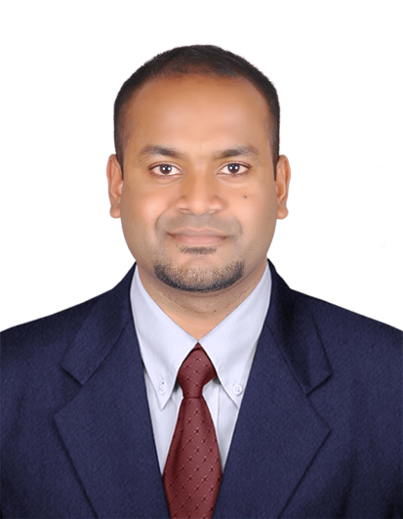
Sanjeeb Goldar
Professional background & Profile
Added value for the Clients
Enabled Organizations to improve operational efficiency , Strengthen AI governance, enhance regulatory compliances, optimize business process, , improve data quality and traceability, reduce operational risks, strengthen audit readiness, and drive responsible adoption of Gen AI technology through business analysis and Governance practices.
Techno-Functional Business Analyst and Transformation Consultant with 11+ years of experience delivering Business Analysis, Digital Transformation, GenAI Governance, AI Risk & Compliance, Data Transformation, Process Mining, Enterprise Applications, and Finance Transformation initiatives across BFSI, Insurance and Pharmaceutical.
Specialized in GenAI Testing, AI Governance, AI Audit, Responsible AI, Data Governance, Business Process Optimization, UAT Management, and Enterprise Transformation programs involving Databricks, Celonis, SAP S/4HANA, ServiceNow Enterprise Architecture, Guidewire PolicyCenter, and Cloud-based Analytics platforms.
Extensive experience in Requirement Gathering, GAP Analysis, BPMN Process Modelling, BRD/FRD preparation, User Stories, RTM creation, Functional Testing, UAT Coordination, Defect Management, Stakeholder Management, Data Validation, Process Mining, Workflow Optimization, and Governance Reporting.
Strong understanding of AI Governance frameworks including NIST AI RMF, ISO/IEC 42001, EU AI Act, GDPR, DPDP, Responsible AI Principles, Model Governance, AI Risk Management, and AI Control Validation.
Experienced in GenAI Testing and Validation activities including Prompt Testing, Response Validation, Hallucination Assessment, Output Quality Validation, Retrieval-Augmented Generation (RAG) Validation, Prompt Injection Testing, Explainability Assessment, Human-in-the-Loop Validation, Bias Testing, AI Control Testing, and Governance Compliance Reviews.
Lead Consultant 4B (Finance Transformation|Databricks BA| AI Governance)
+91 9742982734
Sanjeeb.goldar@genpact.com
Skills
GenAI Testing and validation.
GenAI Governance, compliance and audit.
Databricks & Data Validation
Celonis Process Mining
BPMN Process Modelling
SAP S/4HANA
Guidewire PolicyCenter
Data Governance & Lineage
BRD / FRD / User Stories
UAT & Functional Testing
Reconciliation & Workflow Validation
SAP HANA & MySQL
API Testing & REST APIs
Agile / Scrum / Jira / Confluence
Stakeholder Management
GenAI Risk & Compliance
Industry /Domain
BFSI & Pharmaceutical
Insurance Domain.
RTR Transformation
Digital Transformation
Databricks & Data Governance
Process Mining & BPMN
GenAI Risk & Compliance
Relevant Experience Summary
Delivered Business Analysis and Digital Transformation initiatives across GenAI Governance, Databricks, SAP S/4HANA RTR, Celonis Process Mining, and Enterprise Reporting programs.
Supported GenAI Governance, AI Risk Management, AI Testing, AI Compliance Reviews, AI Control Validation, Audit Readiness, and Responsible AI initiatives aligned with NIST AI RMF and ISO/IEC 42001.
Performed GenAI Testing activities including Prompt Testing, Response Validation, Hallucination Assessment, RAG Validation, Prompt Injection Testing, and Functional Testing of AI-enabled applications.
Delivered Databricks Data Transformation initiatives involving Data Lineage, Source-to-Target Mapping, Data Validation, Reconciliation, Reporting Automation, and Dashboard Validation.
Delivered SAP S/4HANA RTR Transformation programs involving Journal Validation, Financial Reconciliation, Month-End Close, Financial Reporting, Workflow Automation, and Audit Readiness.
Implemented Celonis Process Mining solutions for process analysis, KPI monitoring, bottleneck identification, workflow optimization, and continuous improvement.
Developed BRDs, FRDs, User Stories, BPMN Process Flows, RTMs, UAT Test Cases, and Governance Artefacts while coordinating business, technology, audit, and compliance stakeholders.
Roles
Business Analyst
RTR/PTP Transformation Consultant
Databricks Functional Analyst
PMO & UAT Lead
GenAI Risk & Compliance Auditor
Process Mining Consultant

